Slide 1
Large Form Factor (LFF) ODM SMT Equipment Enabling
Intel – Mitac Collaboration
November XX, 2020
CNDA # NNNNNNNN

Slide 2
Legal Disclaimer, Terms, & Conditions:
INFORMATION IN THIS DOCUMENT IS PROVIDED IN CONNECTION WITH INTEL PRODUCTS. NO LICENSE, EXPRESS OR IMPLIED, BY ESTOPPEL OR OTHERWISE, TO ANY INTELLECTUAL PROPERTY RIGHTS IS GRANTED BY THIS DOCUMENT. EXCEPT AS PROVIDED IN INTEL'S TERMS AND CONDITIONS OF SALE FOR SUCH PRODUCTS, INTEL ASSUMES NO LIABILITY WHATSOEVER AND INTEL DISCLAIMS ANY EXPRESS OR IMPLIED WARRANTY, RELATING TO SALE AND/OR USE OF INTEL PRODUCTS INCLUDING LIABILITY OR WARRANTIES RELATING TO FITNESS FOR A PARTICULAR PURPOSE, MERCHANTABILITY, OR INFRINGEMENT OF ANY PATENT, COPYRIGHT OR OTHER INTELLECTUAL PROPERTY RIGHT.
UNLESS OTHERWISE AGREED IN WRITING BY INTEL, THE INTEL PRODUCTS ARE NOT DESIGNED NOR INTENDED FOR ANY APPLICATION IN WHICH THE FAILURE OF THE INTEL PRODUCT COULD CREATE A SITUATION WHERE PERSONAL INJURY OR DEATH MAY OCCUR.
Intel may make changes to specifications and product descriptions at any time, without notice. The information here is subject to change without notice. Do not finalize a design with this information. All products, computer systems, dates, and figures specified are preliminary based on current expectations, and are subject to change without notice.
The products described in this document may contain design defects or errors known as errata which may cause the product to deviate from published specifications. Current characterized errata are available on request.
Intel, the Intel logo, other Intel brand name(s), and any other Intel logos are registered trademarks of Intel. Intel's trademarks may be used publicly with permission only from Intel. Fair use of Intel's trademarks in advertising and promotion of Intel products requires proper acknowledgement.
*Other names and brands are the property of their respective owners.
Copyright © 2020, Intel Corporation

Slide 3
Discussion Agenda: SMT LFF Equipment Enablement
Upcoming Intel Server Sockets
Intel Equipment Assessment 2019/20 & Equipment Verification
Intel Requested Feedback
Q and A’s

Slide 4

Factory Readiness for Upcoming Intel Server Sockets
Socket Features | Current/Prior | Upcoming Server Sockets
 | Socket P4/5 | Socket E | Socket BR
Size (mm) | 82 x 62 (~41 x 31 per piece) | 82 x 64.5 | 109 x 75
Socket Design | 2 pieces | 1 piece | 1 piece
Weight (g) | 15 per piece | 26 | 39
Total Number of Solder Bumps | 4189 | 4677 | 7529
Target Q/Y Production Readiness | Launched | Q2’21 | Q2’22
Key Message
With new Large Form factor (LFF) socket it is important to assess PnP SMT & Rework tool Capability
Intel would like to understand SMT and rework status/readiness to manufacture the parts
Notes:
This is an AP platform, 12 socket server
Limited

Slide 5
Intel Equipment Assessment 2019/20 - PnP and Rework Equipment Verification
PNP Machine (Current Capability) |  |  |  | PNP Capability Assessment |  | Current No of Lines w/PNP Models
ODM (PRC/TW) | Vendor | Model | Max Size | Socket E (82 x 64.5 mm) | Socket BR (109 x 75 mm) | What component is the PnP equip used to place? | Current Quantity of Tools (existing Models) | Planned Upgrades Quantity (2021-2023) for newer or other Models
Mitac | Fuji | AIMEX-III | 120 x 120 mm | Y | Y
 |  | NXT II | 74 x 74 mm | N | N
Table to be filled by Mitac
Rework Machine (Current Capability) |  |  |  | Rework Capability Assessment |  | Current No of Lines w/rework Models
ODM (PRC/TW) | Vendor | Model | Max Size | Socket E (82 x 64.5 mm) | Socket BR (109 x 75 mm) | Current Quantity at (existing Models) | Planned Upgrades Quantity (2021-2023) for newer or other Models
Mitac | VJE | SRT-1800 | 80 x 80 mm (with prism upgrade) | N | N
Table to be filled by Mitac
*SRT-1800 may have some technical challenges
Key Message
Intel would like to understand the current tool is capable of handling socket E and Socket BR for manufacturing
Are there plans to purchase new equipment or upgrade current equipment
Notes:
*Intel recommends to use Summit LXI for Socket E due to rework challenge
Intel would like to understand what financial impacts might be incurred if additional updates are required for handling future products

Slide 6
Intel Requests/Help Needed
Intel would like to verify the capability of your SMT PnP and rework equipment for Socket E/Socket BR
  Intel can share collaterals to perform the assessments (sockets/PCBs)
Intel would like to collaborate and provide an opportunity for early assessment/readiness checks with Socket BR.
  Intel will share needed collaterals (sockets/PCBs) when available
Notes:
Speak to MV proposal if customer would like to perform with Intel
If ODM does not have the equipment currently for Socket E/BR
Any help needed with choosing the correct equipment/tools?

Slide 7


Slide 9

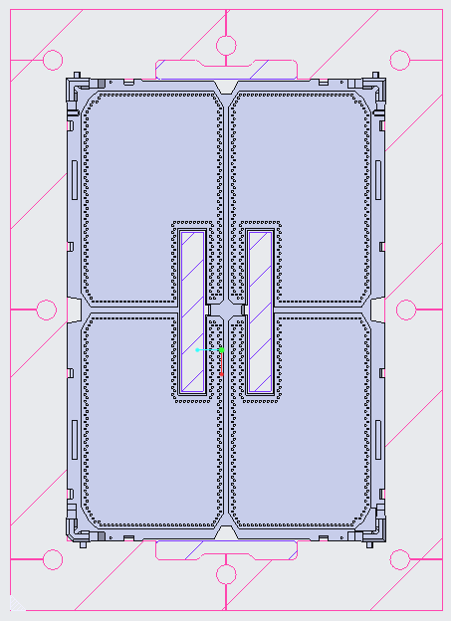

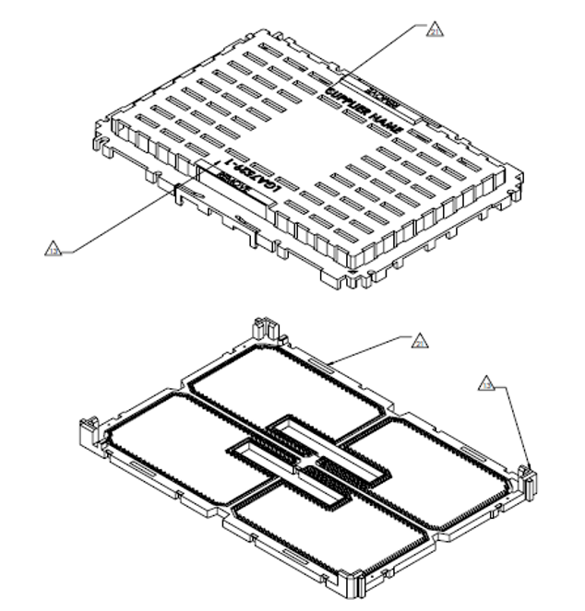

Socket-E v Socket-BR
82 mm
112 mm
120 mm
142 mm
62 mm
75 mm
80 mm
102 mm
Top-Down view with socket X,Y dimensions and Iso View of Socket E
Top-Down view with socket X,Y dimensions and Iso View of Socket BR
Notes:
Add a top down view, side by side comparison

